Slide 1
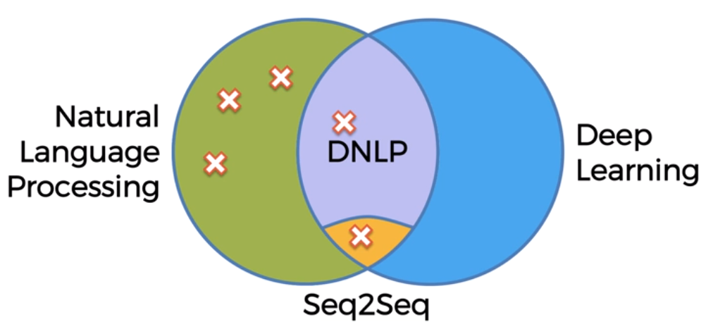
NLP-Natural Language Processing

Slide 2
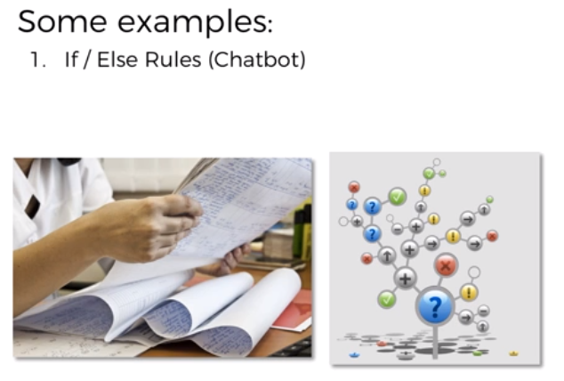
NLP-Natural Language Processing
This is a way that we used to create chatbots back in the day. So if/else rules are located over here on our diagram in just the NLP part, and what they entail is a huge list of possible questions and answers to those questions.
So once somebody in the chat asks a question, or we can identify that part of the sentence is the question that we have pre-recorded, then we will give them the correct answer, the answer that is associated with that question. But as you can imagine, such a mechanical approach to answering questions or chatting with people does not result in anything humanlike, anything realistic.
But people want something tailored to them, something specific, they're asking about something else, but doesn't fit into that list of questions and answers. And it just very quickly becomes a mess.

Slide 3
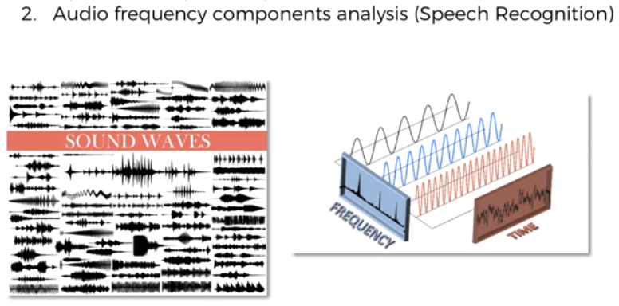
NLP-Natural Language Processing
A very general overview of what happens. We look at the frequencies, certain mathematical operations and we're not doing any neural computations or not creating any neural networks. We're just doing mathematical calculations
around the frequencies that we can observe, comparing them to the mathematical calculations we have in our library of pre-analyzed frequencies. And then we are matching it up. We're finding what word a person is saying, what question they're asking or what the sentence is meaning. And then that is how we recognize speech.

Slide 4
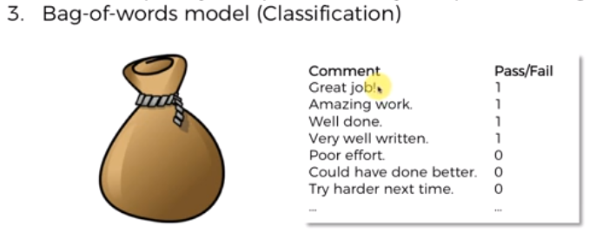
NLP-Natural Language Processing
It'll look at the words and try to classify these words or associate these words with either positive results or a negative result in our case. And so in this case, like amazing would be most likely associated with positive view. But then these other words like poor or harder would be associated with zeros. So then it'll remember and keep these words in a bag and next time something comes up, for instance, somebody says good, good job, keep, keep it up or something like that, it will analyze the words that are in that new sentence by pulling them out of the bag and looking at them and understanding are they mostly associated ones or zeros? And then it'll be able to predict or classify the new comment, even without knowing what the mark was, pass or fail.

Slide 5
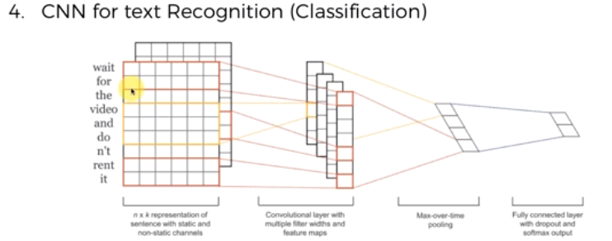
NLP-Natural Language Processing
It's called convolutional neural networks for text recognition then further for classification, which is indeed a deep natural language process model. It's a neural network that is used for mostly image recognition for like videos, self-driving cars use them to detect obstacles on roads, people and so on. So mostly it's used for image processing or video processing. The way it works is, these words are transformed into a matrix and that's done through an operation called embedding of words and once they're in a matrix, the same principles as were applied for images in convolutional neural networks, are applied. There's a convolution operation going through these images. Then they're pooled, max pooled or min pooled or sum pooled, and then they're flattened and we have the prediction. It’s just an overview

Slide 6
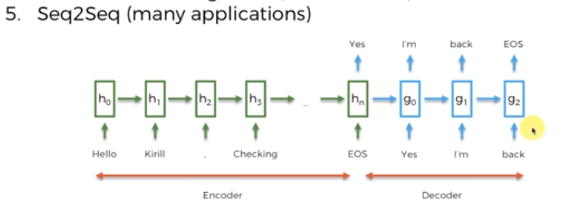
NLP-Natural Language Processing
Each word that you used to type was converted to its target language giving no regard to its grammar and sentence structure. Seq2seq revolutionized the process of translation by making use of deep learning. It not only takes the current word/input into account while translating but also its neighbourhood. Seq2Seq (Sequence-to-Sequence) is a type of model in machine learning that is used for tasks such as machine translation, text summarization, and image captioning. The model consists of two main components:
Encoder
Decoder
Seq2Seq models are trained using a dataset of input-output pairs, where the input is a sequence of tokens and the output is also a sequence of tokens. The model is trained to maximize the likelihood of the correct output sequence given the input sequence.

Slide 7
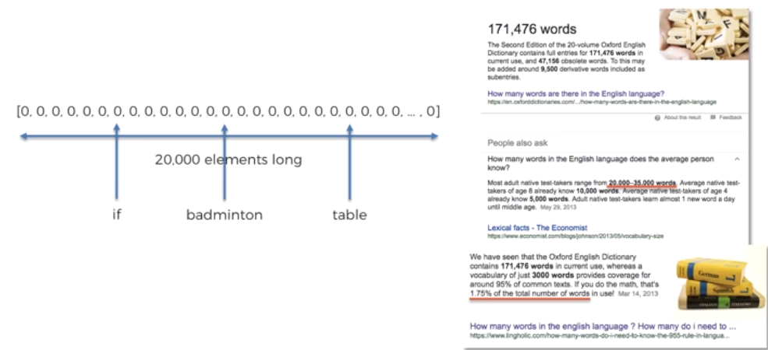
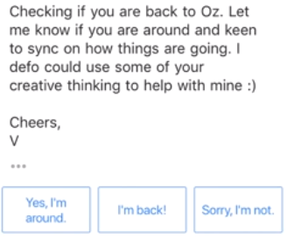
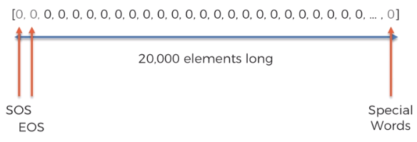
Bag Of Words

Slide 8
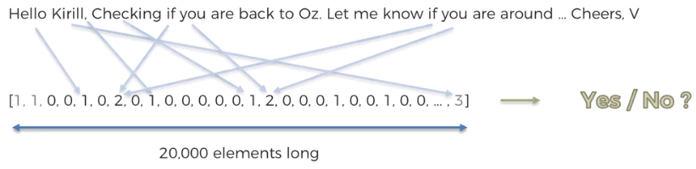
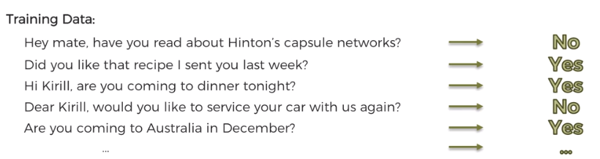
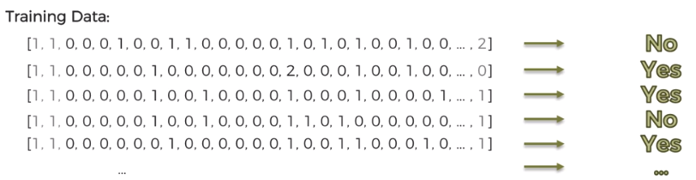
Bag Of Words

Slide 9
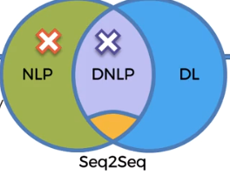
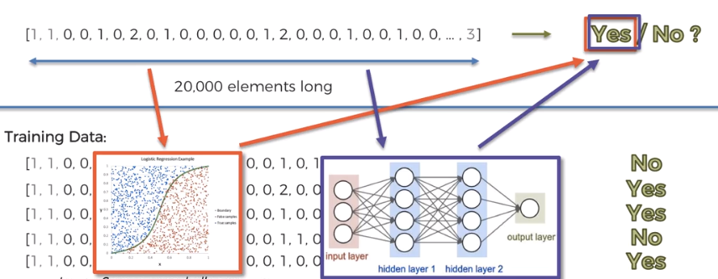

Bag Of Words

Slide 10
Deep Learning
Deep Learning is the most exciting and powerful branch of Machine Learning. Deep Learning models can be used for a variety of complex tasks:
Artificial Neural Networks for Regression and Classification
Convolutional Neural Networks for Computer Vision
Recurrent Neural Networks for Time Series Analysis
Self Organizing Maps for Feature Extraction
Deep Boltzmann Machines for Recommendation Systems
Auto Encoders for Recommendation Systems

Slide 11
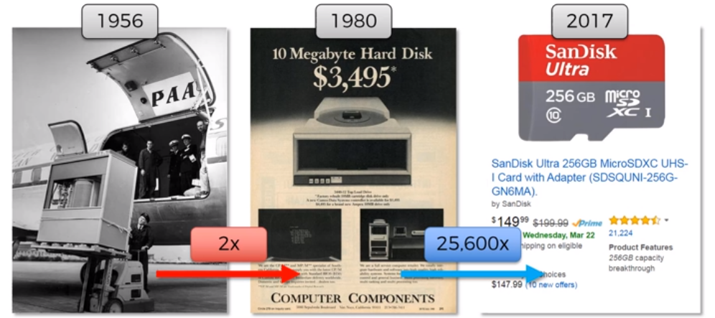
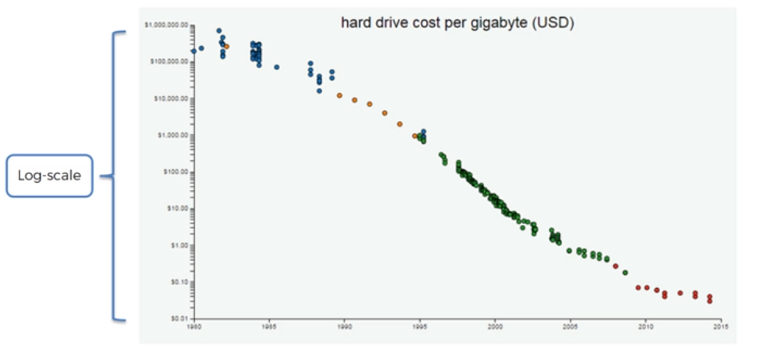
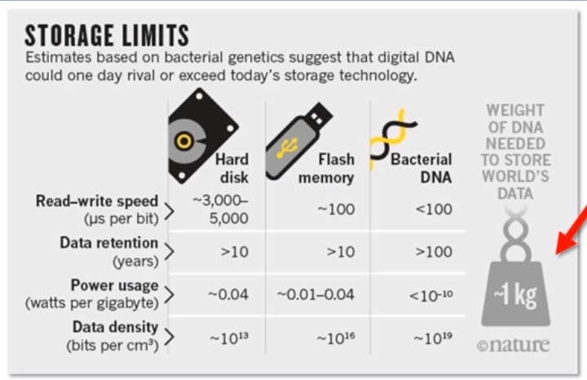
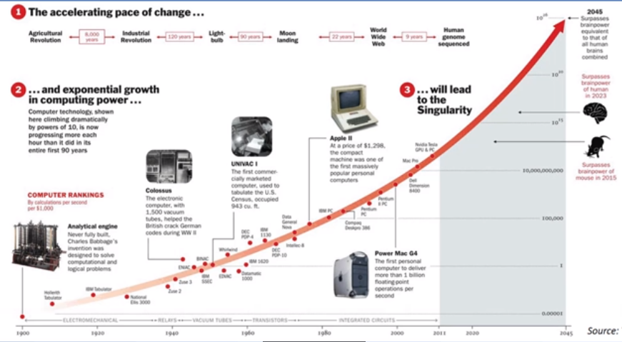
Deep Learning

Slide 12
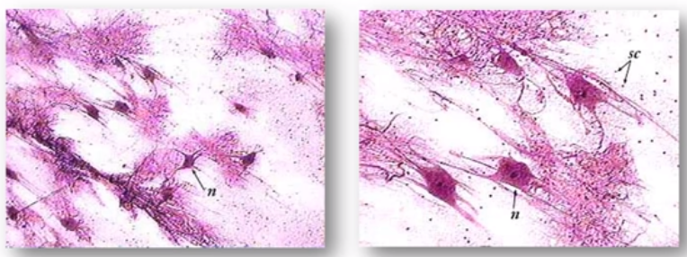
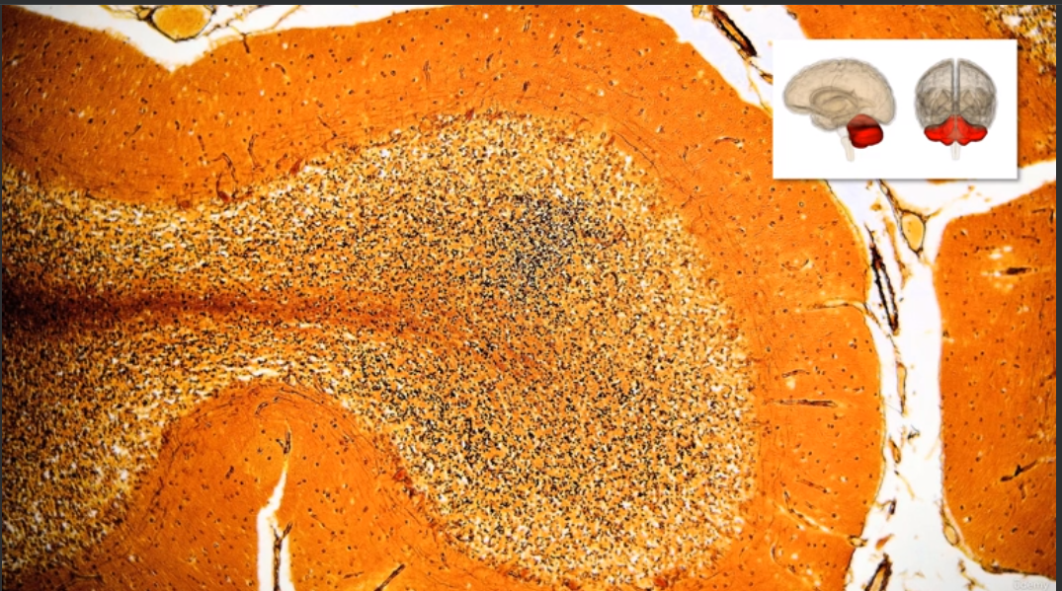
Deep learning
Here we've got some neurons, so these are neurons which are having smeared onto glass and being looked at under a microscope with some coloring. And this is, you can see what they look like. So they have a like a body, they have these branches and they have like tails and so on. We can see they have like a nucleus inside in the middle and that's basically what a neuron looks like. In the human brain, there's approximately a hundred billion neurons altogether. So these are individual neurons,there are actually modern neurons because they're bigger, they're easier to see. But, nevertheless, there's a hundred billion neurons in the human brain and each neuron is connected to as many as a thousand of its neighbors.

Slide 13
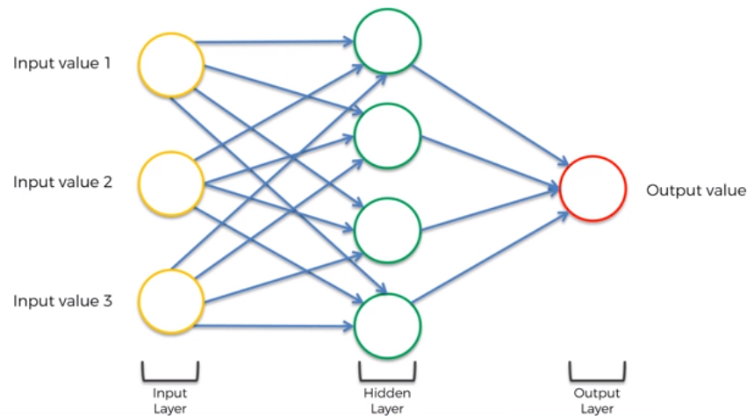
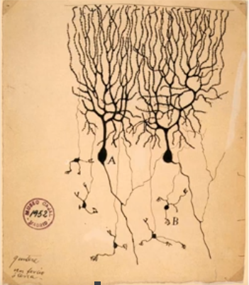
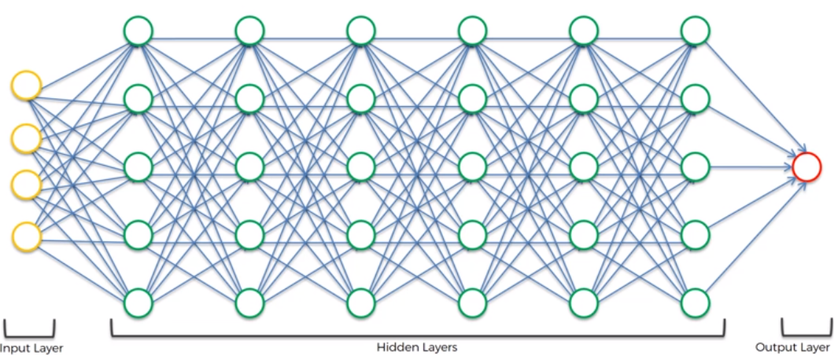
Deep learning

Slide 14
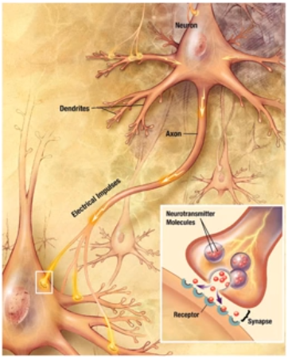
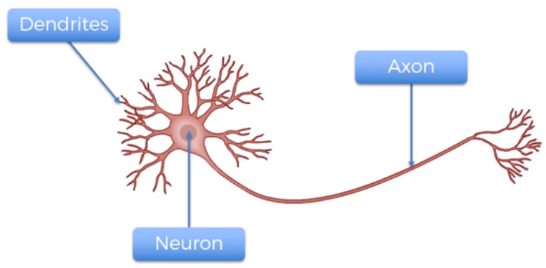
Deep learning- Neuron

Slide 15
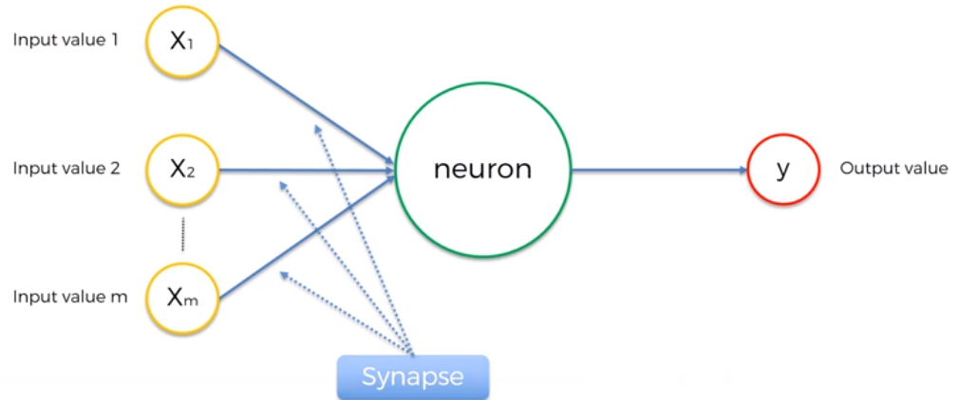
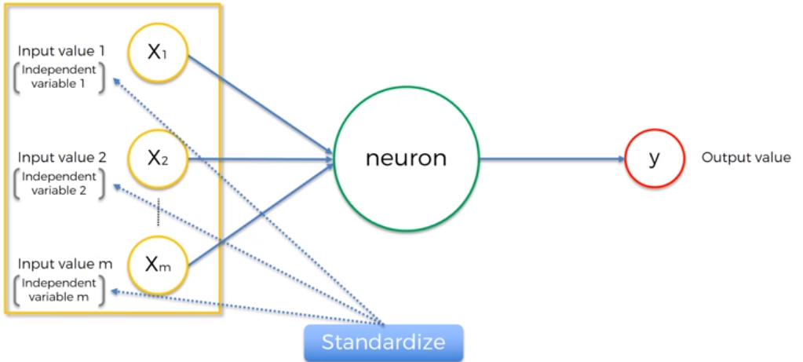
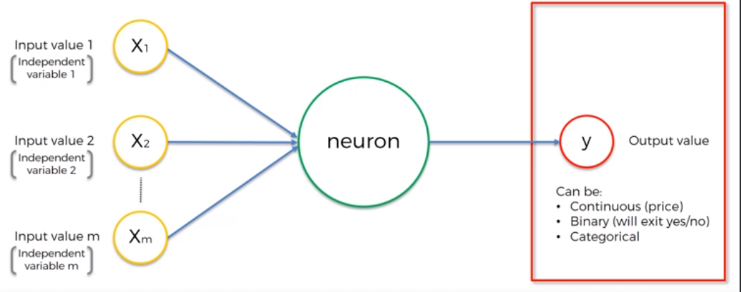
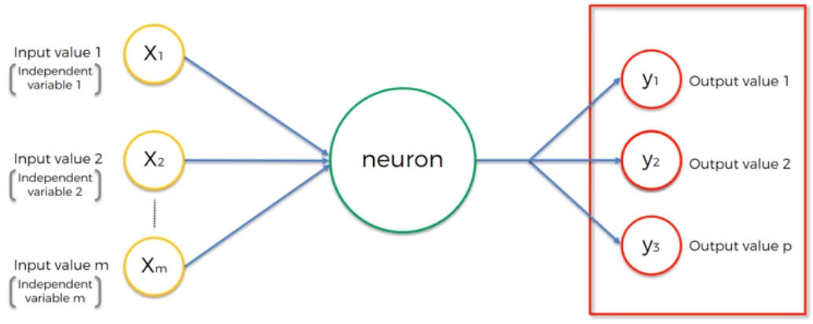
Deep learning- Neuron
For Categorical target, we will have multiple Output values

Slide 16
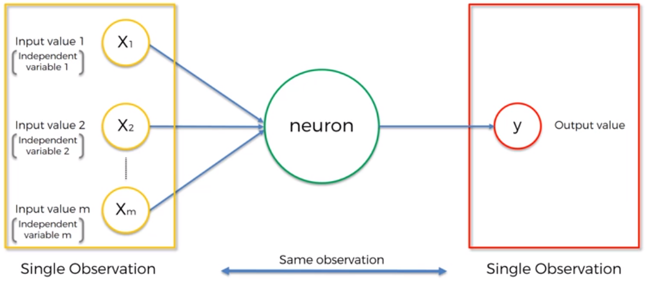
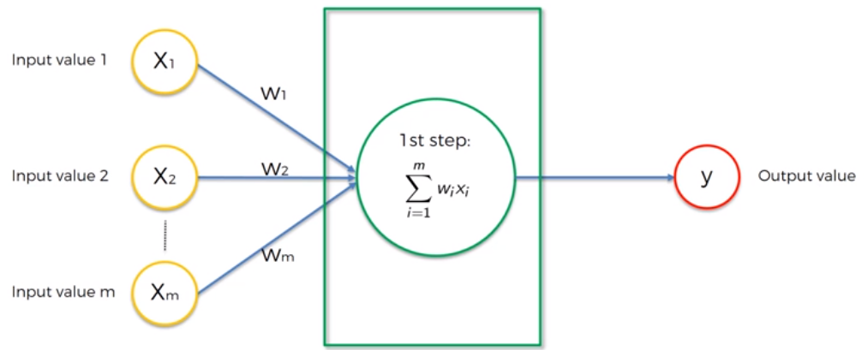
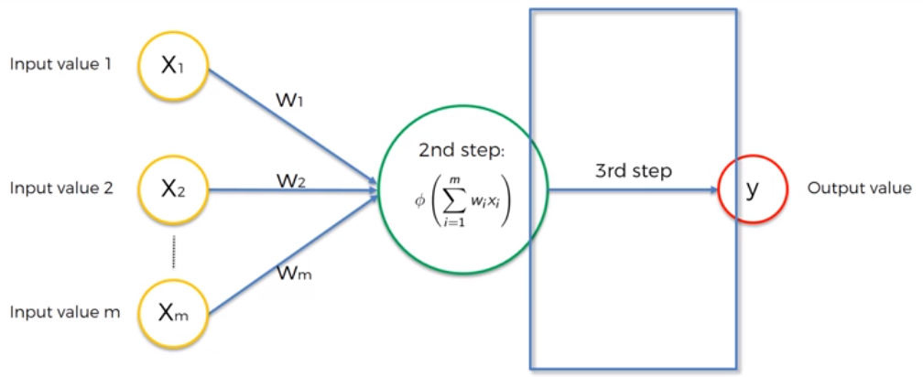
Deep learning- Neuron
Weights are how neural networks learn by adjusting the weights. The neural network decides in every single case what signal is important, what signal is not important to a certain neuron. What signal gets passed along and what signal doesn't get passed along, or to what strength, to what extent signals get passed along. So weights are crucial.
Signals go into the neuron and the weighted sum of all of the input values gets added in the first step and then it applies an activation function to this neuron or to this whole layer on top of this weighted sum and then from that, the neuron understands if it will either pass on a signal or it won't pass the signal on.

Slide 17
Deep learning- The Activation Function
Elements of a Neural Network
Input Layer: This layer accepts input features. It provides information from the outside world to the network, no computation is performed at this layer, nodes here just pass on the information(features) to the hidden layer.
Hidden Layer: Nodes of this layer are not exposed to the outer world, they are part of the abstraction provided by any neural network. The hidden layer performs all sorts of computation on the features entered through the input layer and transfers the result to the output layer.
Output Layer: This layer bring up the information learned by the network to the outer world.
What is an activation function and why use them?
The activation function decides whether a neuron should be activated or not by calculating the weighted sum and further adding bias to it. The purpose of the activation function is to introduce non-linearity into the output of a neuron.
Explanation: We know, the neural network has neurons that work in correspondence with weight, bias, and their respective activation function. In a neural network, we would update the weights and biases of the neurons on the basis of the error at the output. This process is known as back-propagation. Activation functions make the back-propagation possible since the gradients are supplied along with the error to update the weights and biases.
Why do we need Non-linear activation function?
A neural network without an activation function is essentially just a linear regression model. The activation function does the non-linear transformation to the input making it capable to learn and perform more complex tasks.

Slide 18

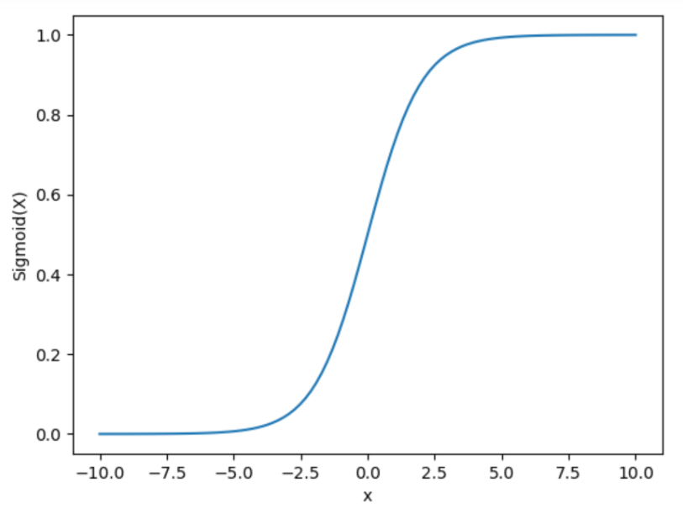
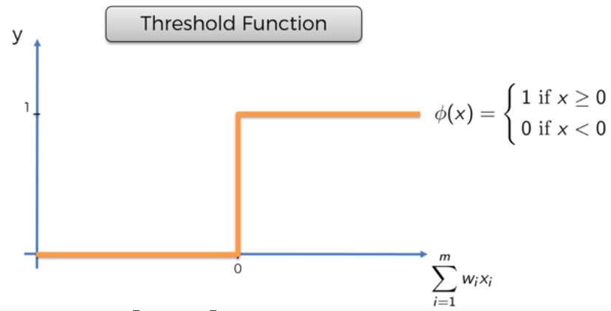
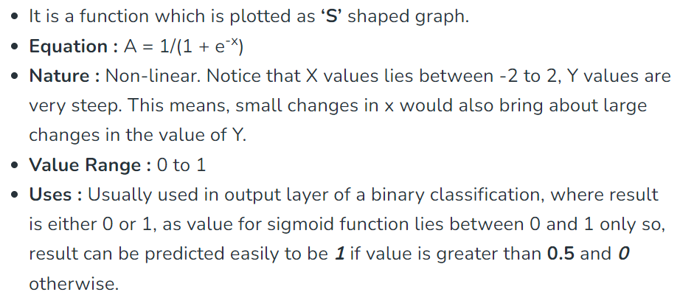
Deep learning- The Activation Function

Slide 19
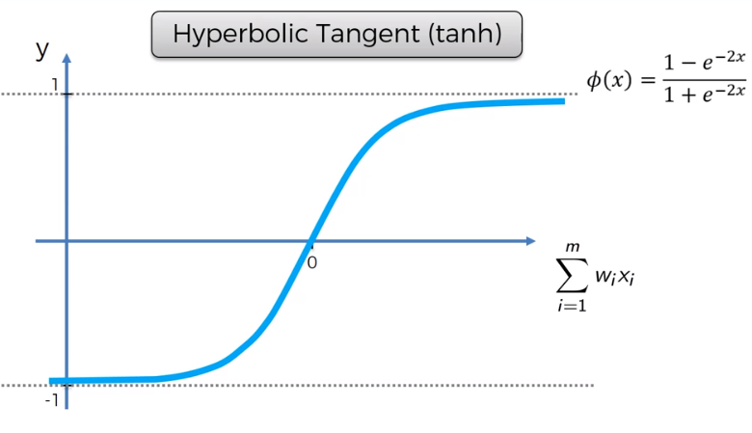
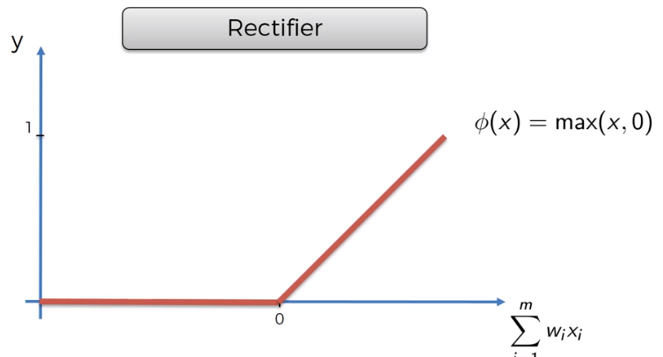
Deep learning- The Activation Function
It Stands for Rectified linear unit. It is the most widely used activation function. Chiefly implemented in hidden layers of Neural network.
Equation :- A(x) = max(0,x). It gives an output x if x is positive and 0 otherwise.
Value Range :- [0, inf)
Nature :- non-linear, which means we can easily backpropagate the errors and have multiple layers of neurons being activated by the ReLU function.
Uses :- ReLu is less computationally expensive than tanh and sigmoid because it involves simpler mathematical operations. At a time only a few neurons are activated making the network sparse making it efficient and easy for computation.
In simple words, RELU learns much faster than sigmoid and Tanh function.
The activation that works almost always better than sigmoid function is Tanh function also known as Tangent Hyperbolic function. It’s actually mathematically shifted version of the sigmoid function. Both are similar and can be derived from each other.
Value Range :- -1 to +1
Nature :- non-linear
Uses :- Usually used in hidden layers of a neural network as it’s values lies between -1 to 1 hence the mean for the hidden layer comes out be 0 or very close to it, hence helps in centering the data by bringing mean close to 0. This makes learning for the next layer much easier.

Slide 20
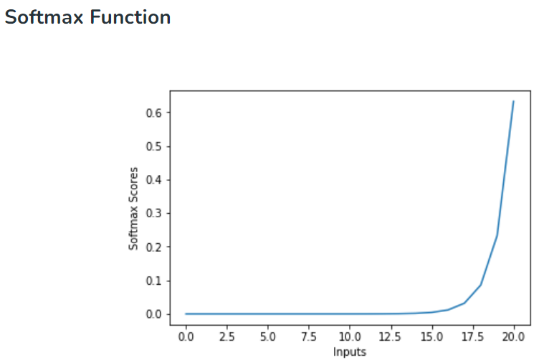
Deep learning- The Activation Function
The softmax function is also a type of sigmoid function but is handy when we are trying to handle multi- class classification problems.
Nature :- non-linear
Uses :- Usually used when trying to handle multiple classes. the softmax function was commonly found in the output layer of image classification problems.The softmax function would squeeze the outputs for each class between 0 and 1 and would also divide by the sum of the outputs.
Output:- The softmax function is ideally used in the output layer of the classifier where we are actually trying to attain the probabilities to define the class of each input.
The basic rule of thumb is if you really don’t know what activation function to use, then simply use RELU as it is a general activation function in hidden layers and is used in most cases these days.
If your output is for binary classification then, sigmoid function is very natural choice for output layer.
If your output is for multi-class classification then, Softmax is very useful to predict the probabilities of each classes.

Slide 21
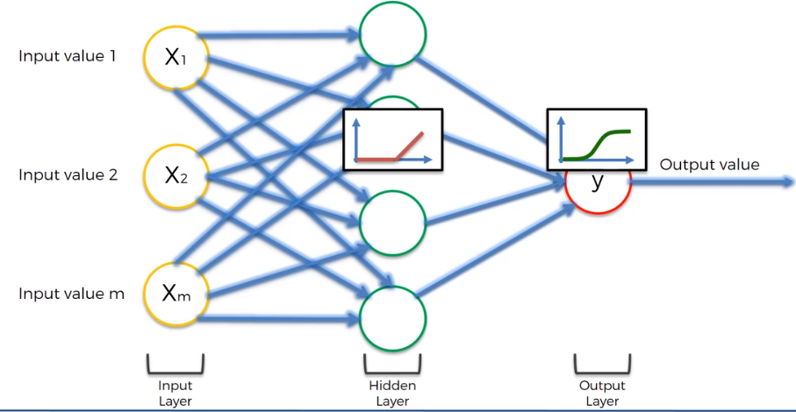
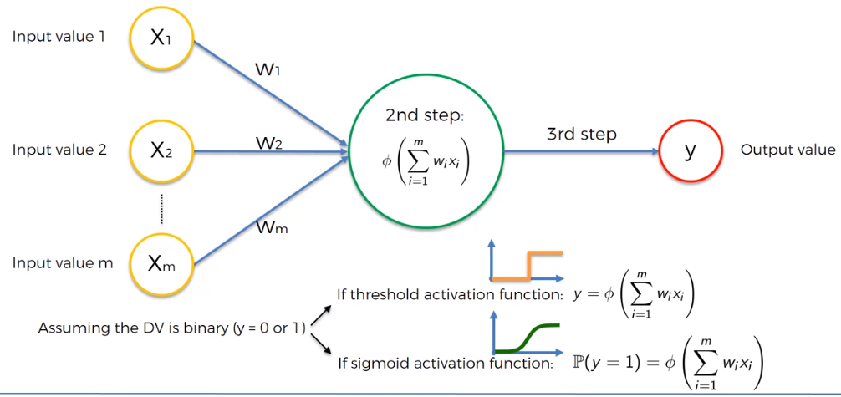
Deep learning- The Activation Function

Slide 22
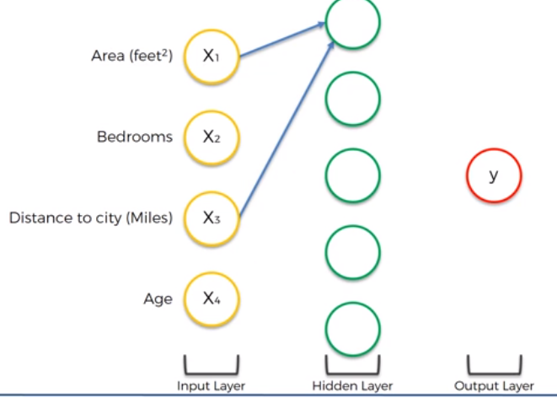
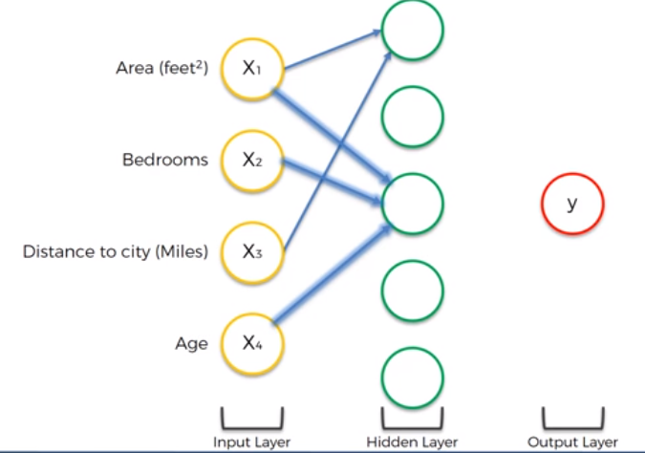
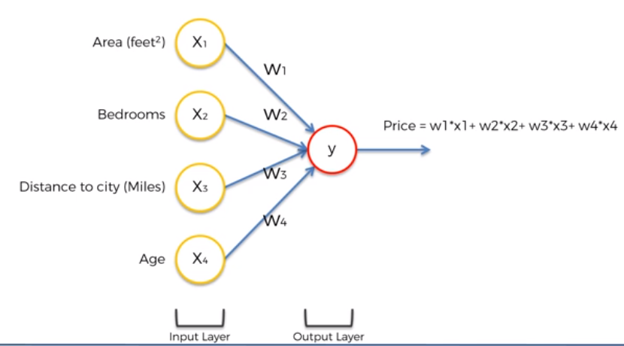
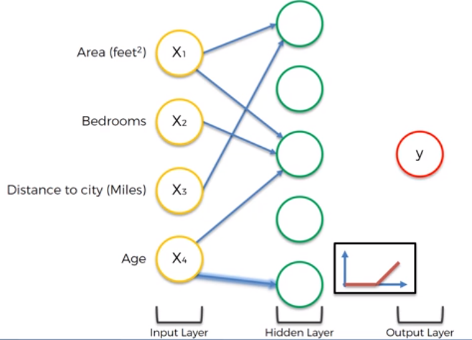
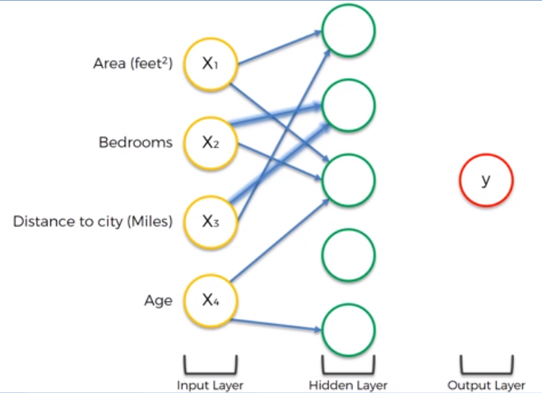
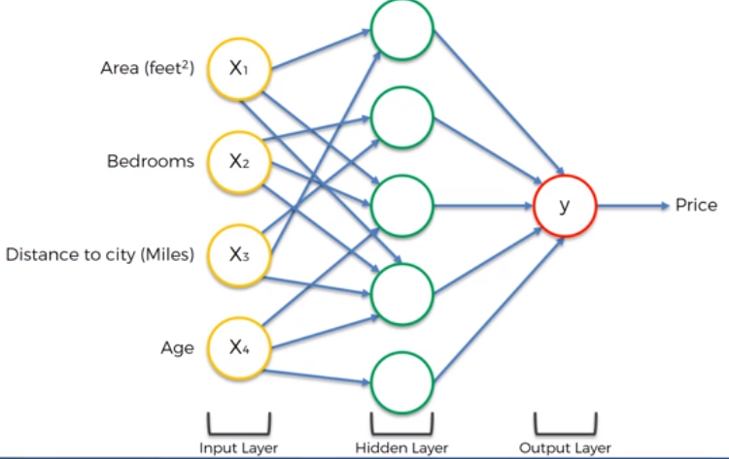
How do Neural Networks Work?

Slide 23
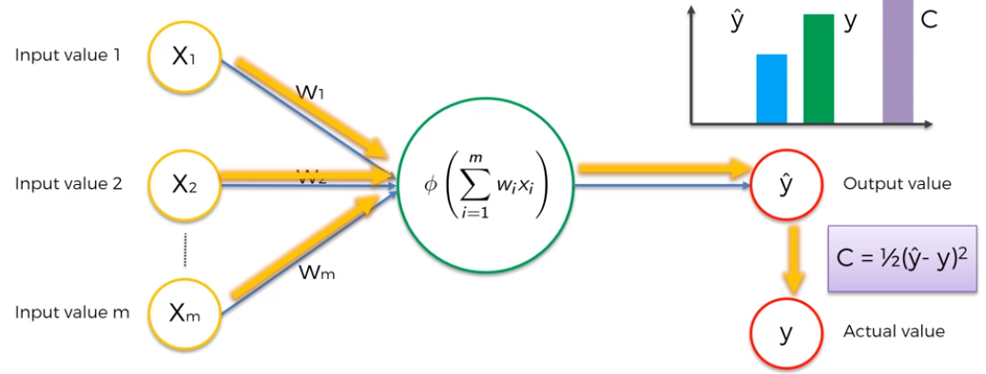
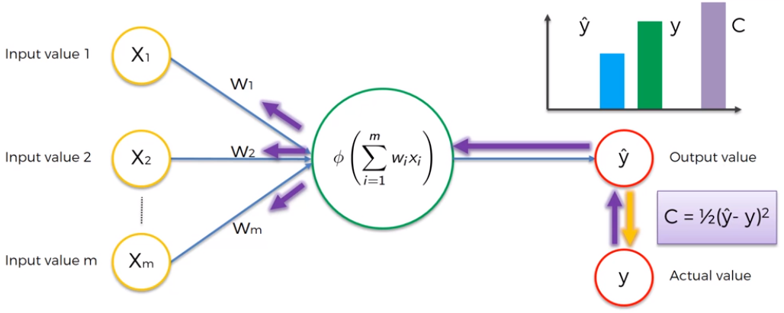
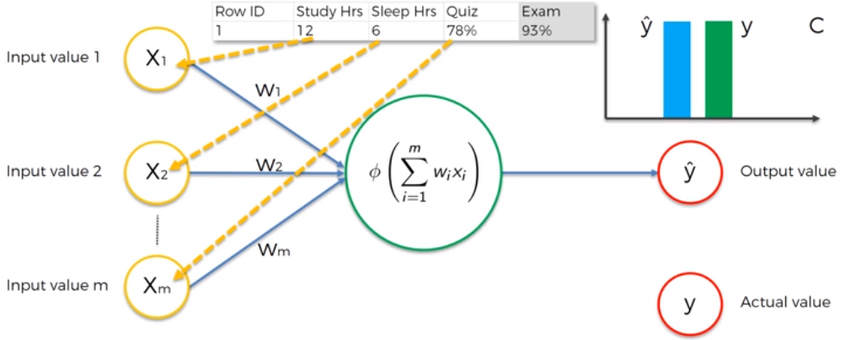
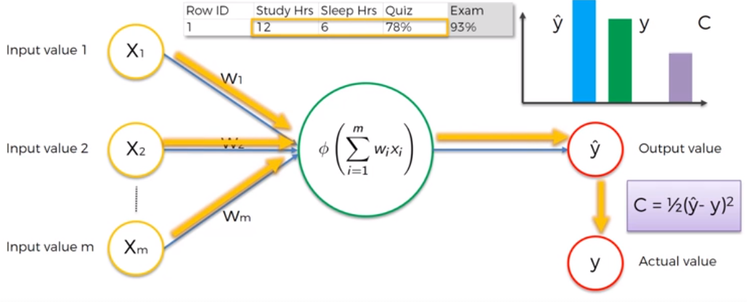


How do Neural Networks Learn?

Slide 24




How do Neural Networks Learn?

Slide 25

Gradient Descent vs Stochastic Gradient Descent

Slide 26



BackPropagation

Slide 27
Number of Neurons In Input and Output Layers
The number of neurons in the input layer is equal to the number of features in the data and in very rare cases, there will be one input layer for bias. Whereas the number of neurons in the output depends on whether is the model is used as a regressor or classifier. If the model is a regressor then the output layer will have only a single neuron but in case if the model is a classifier it will have a single neuron or multiple neurons depending on the class label of the model.
There are many rule-of-thumb methods for determining the correct number of neurons to use in the hidden layers, such as the following:
The number of hidden neurons should be between the size of the input layer and the size of the output layer.
The number of hidden neurons should be 2/3 the size of the input layer, plus the size of the output layer.
The number of hidden neurons should be less than twice the size of the input layer.
Moreover, the number of neurons and number layers required for the hidden layer also depends upon training cases, amount of outliers, the complexity of, data that is to be learned, and the type of activation functions used.
Most of the problems can be solved by using a single hidden layer with the number of neurons equal to the mean of the input and output layer. If less number of neurons is chosen it will lead to underfitting and high statistical bias. Whereas if we choose too many neurons it may lead to overfitting, high variance, and increases the time it takes to train the network.
Notes:
https://medium.com/geekculture/introduction-to-neural-network-2f8b8221fbd3#:~:text=Number%20of%20Neurons%20and%20Number%20of%20Layers%20in%20Hidden%20Layer&text=The%20number%20of%20hidden%20neurons,size%20of%20the%20output%20layer.
https://archive.ics.uci.edu/contribute/donation
https://www.tensorflow.org/api_docs/python/tf/keras/metrics

Slide 28




Slide 29



Convolutional Neural Networks

Slide 30


Convolutional Neural Networks

Slide 31









Convolutional Neural Networks- Step 1 Convolution
Input Image
Feature Detector/Kernel/Filter
Feature/Activation map/Convolved Feature
Notes:
We are moving 1 stride at a time but it can be 2 strides as well depending on the size of the image like 300x300 will have higher number of pixel so reducing it to smaller size will require 2 strides. Also feature Detector can be of any size-3x3 or 5x5 or 7x7 depending on how much you want to reduce the size of the image. Its not fixed.

Slide 32




Convolutional Neural Networks- Step 1 Convolution
Feature Detector

Slide 33

Convolutional Neural Networks- Step 1 Convolution
The primary purpose of a convolution is to find features in your image using the feature detector, put them into a feature map, and by having them in a feature map, it still preserves the spatial relationships between pixels which is very important for us to, you know, because if they're completely jumbled up, then we've lost the pattern and at the same time, it's important to understand that most of the time the features a neural network will detect and use to recognize certain images and classes, will mean nothing to humans but nevertheless, they work.
Spatial relationship is a property of data, and due to which we use CNN to create models. This property defines that the data points in a data unit are related to each other in a way that they cannot be separated, and hence if you do that, or modify them independently, then will corrupt the data unit.
For instance, take an image as a data unit, then each pixel is the data point. The image’s pixel defines the image itself, and making abrupt changes in these pixels actually changes/corrupts/destroys the image. Thus these pixels have relationships with each other which is spatially distributed in each dimension, x (width), and y (height).

Slide 34

Convolutional Neural Networks- Step 1b ReLU Layer
Rectifier acts as that function which breaks up linearity and the reason why we want to increase non-linearity in our network is because images themselves are highly non-linear, especially if you're recognizing different objects next to each other or the image is going to have lots of non-linear elements, and the transition between pixels, adjacent pixels is often got be non-linear. That's, because there's borders, different colors, different elements in your images. But at the same time, when we're applying mathematical operations such as convolution and running this feature detection to create our feature maps, we risk that we might create something linear, and therefore, we need to break up the linearity

Slide 35


Convolutional Neural Networks- Step 2 Pooling

Slide 36









Convolutional Neural Networks- Step 2 Pooling
Box of 2x2 pixels
So, we are preserving the features, introducing spatial invariance (Spatial or Translation Invariance means that if an object occurs in any image it will be detected irrespective of its position.),reducing the size by 75%, which is really gonna help us in terms of processing and moreover, another benefit of pooling is we are reducing the number of parameters. So we're reducing number of parameters by 75% that are going to go into our final layers of the neural network, and, therefore, we're preventing overfitting.

Slide 37

Convolutional Neural Networks- Step 2 Pooling
This layer is periodically inserted in the covnets and its main function is to reduce the size of volume which makes the computation fast reduces memory and also prevents overfitting. Two common types of pooling layers are max pooling and average pooling.

Slide 38



Convolutional Neural Networks- Step 3 Flattening
The resulting feature maps are flattened into a one-dimensional vector after the convolution and pooling layers so they can be passed into a completely linked layer for categorization or regression.

Slide 39


Convolutional Neural Networks- Step 4 Full Connection
In artificial neural networks, hidden layers don't have to be fully connected whereas in convolution neural networks we're gonna be using fully connected layers, and that's why they're generally called fully connected layers. So, basically that whole column or vector of outputs that we have after the flattening (features encoded in numbers), get passed into the input layer. The main purpose of the artificial neural network is to combine our features into more attributes that predict the classes even better.
In here, the weights are adjusted along with the feature detectors adjustment as it might be possible that we're looking for the wrong features, so the feature detectors are adjusted so that maybe next time it’ll be better.

Slide 40

Convolutional Neural Networks- Summary
Notes:
https://www.tensorflow.org/api_docs/python/tf/keras/preprocessing/image/ImageDataGenerator
https://keras.io/api/
https://keras.io/api/layers/convolution_layers/convolution2d/#:~:text=2D%20convolution%20layer%20(e.g.%20spatial,to%20the%20outputs%20as%20well.

